Slide 1

St. Himark Data Story
Name Here

Slide 2
Overview
The data story illustrates the trends of the aftermath of the 2020 St. Himark earthquake damages and intensity throughout the neighbourhoods, and the radiation measurement readings during the month of April.
Data story illustrations
Visually Appealing
Report Trends over time

Slide 3
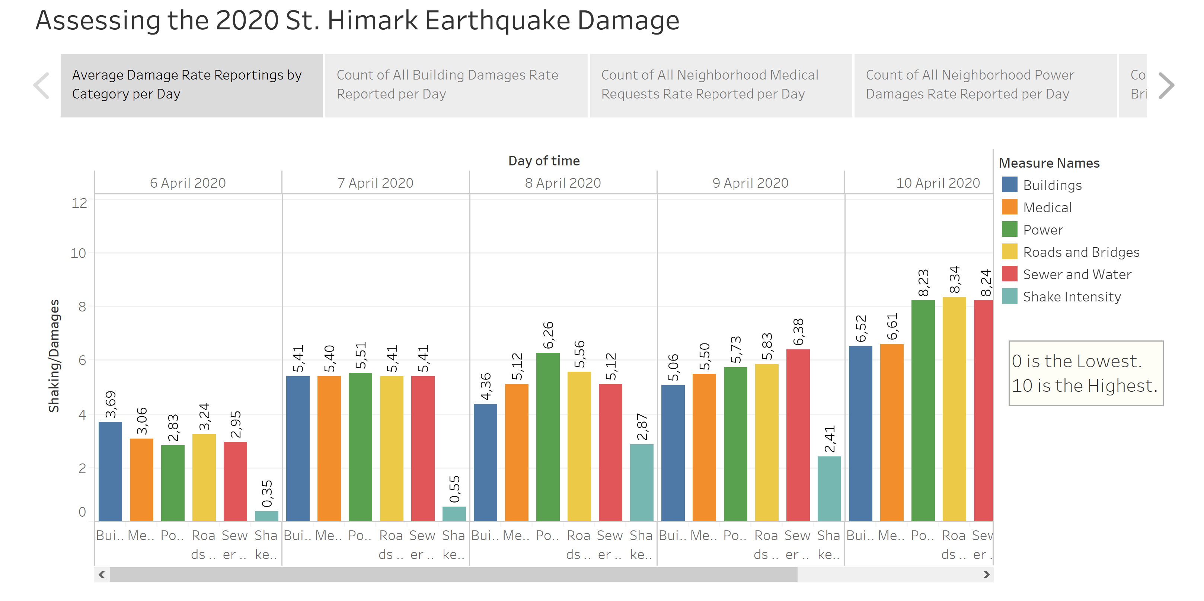
Average Damage Rate Reporting’s by Category per Day

Slide 4
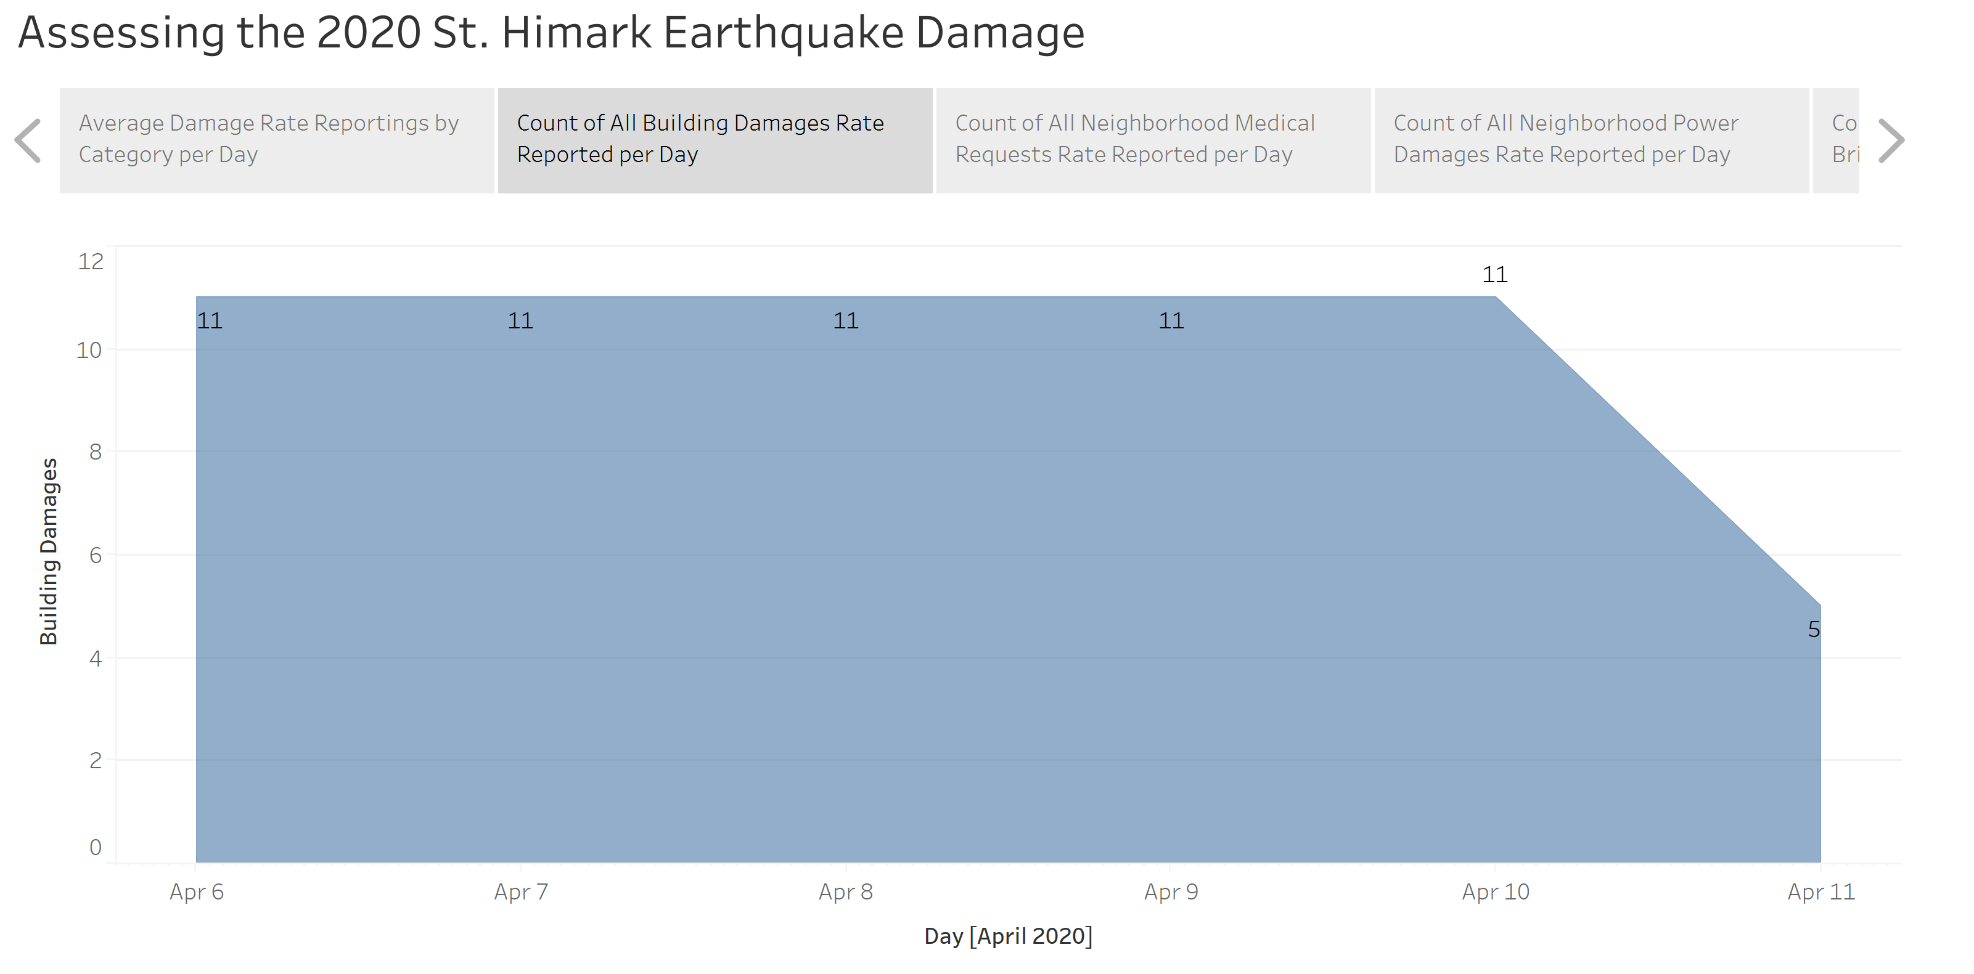
Count of All Neighbourhood Building Damages Rate Reported per Day

Slide 5
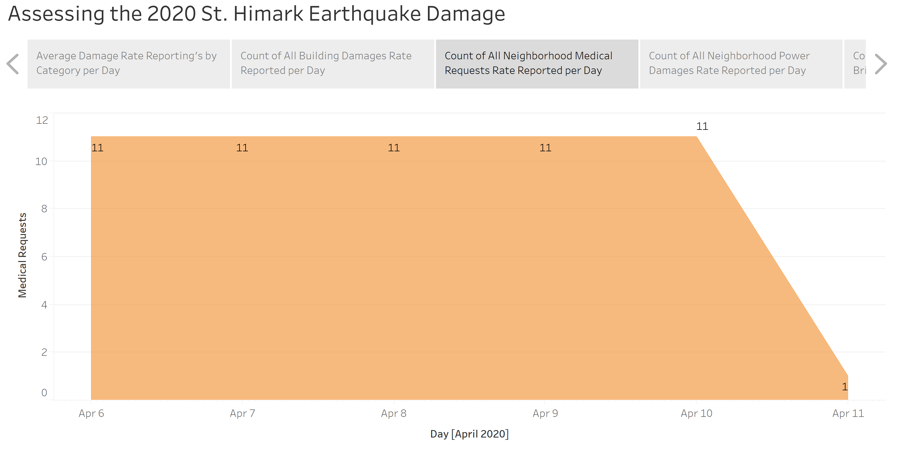
Count of All Neighbourhood Medical Requests Rate Reported per Day

Slide 6
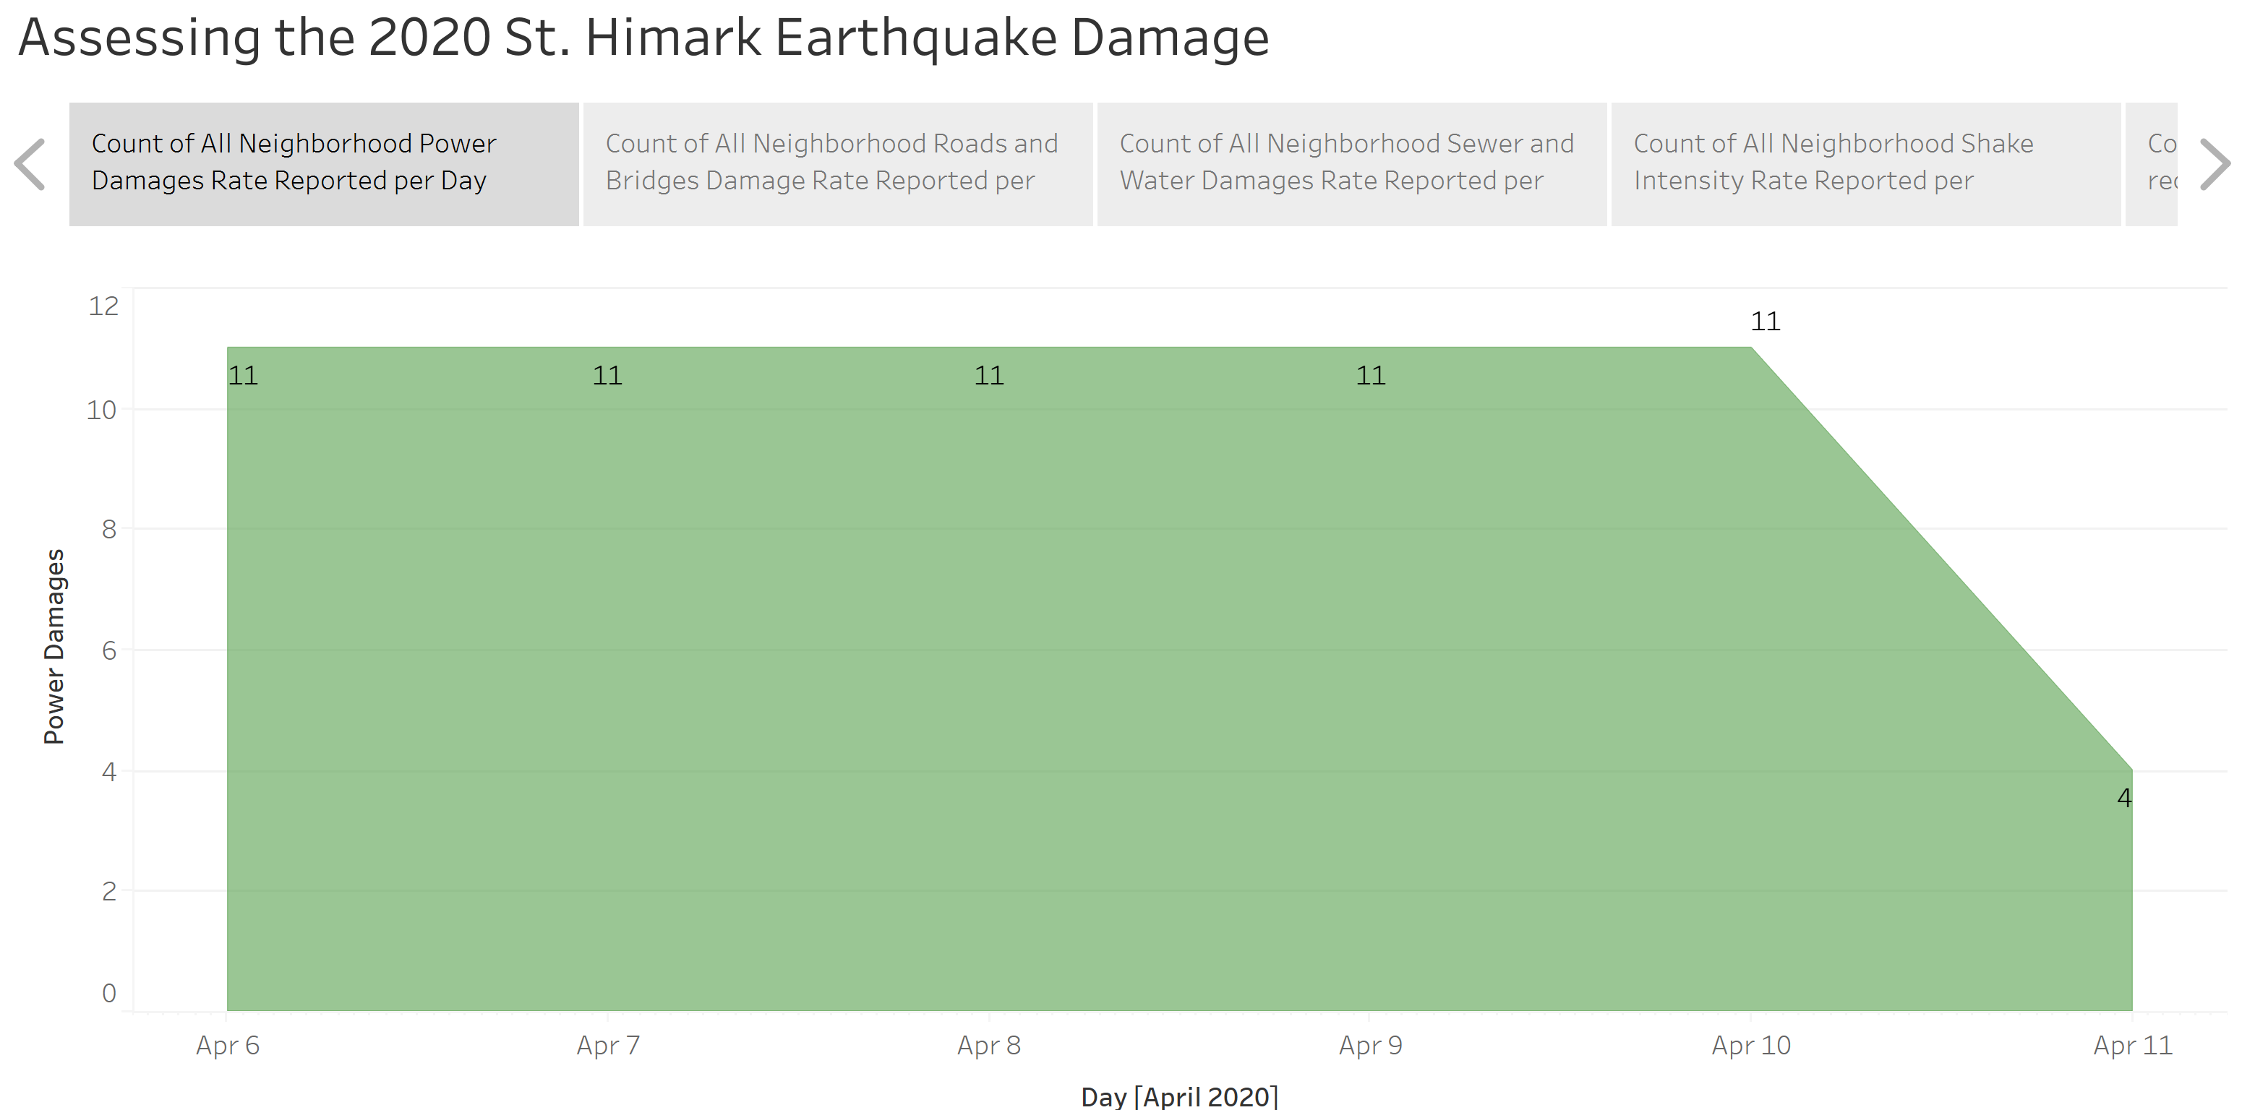
Count of All Neighbourhood Power Damages Rate Reported per Day

Slide 7
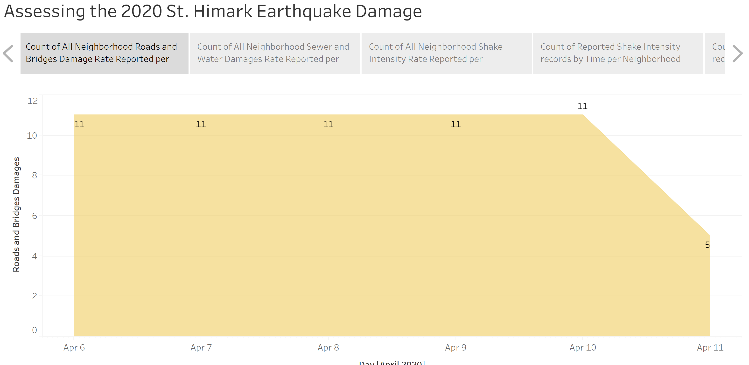
Count of All Neighbourhood Roads and Bridges Damage Rate Reported per Day

Slide 8
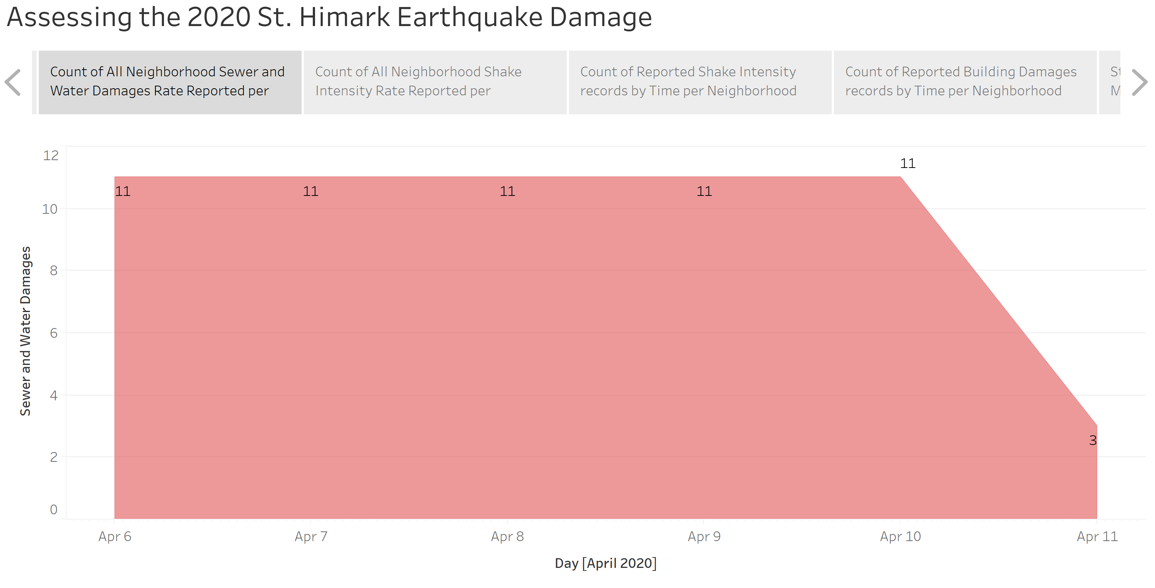
Count of All Neighbourhood Sewer and Water Damages Rate Reported per Day

Slide 9
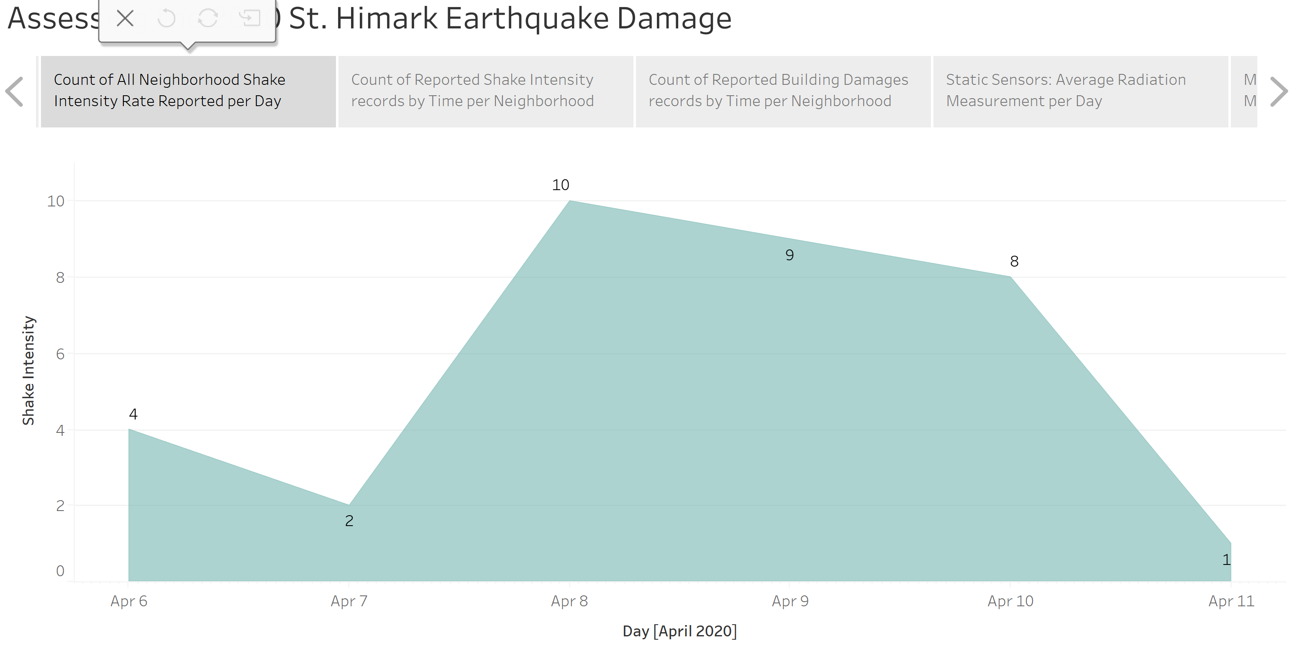
Count of All Neighbourhood Shake Intensity Rate Reported per Day

Slide 10
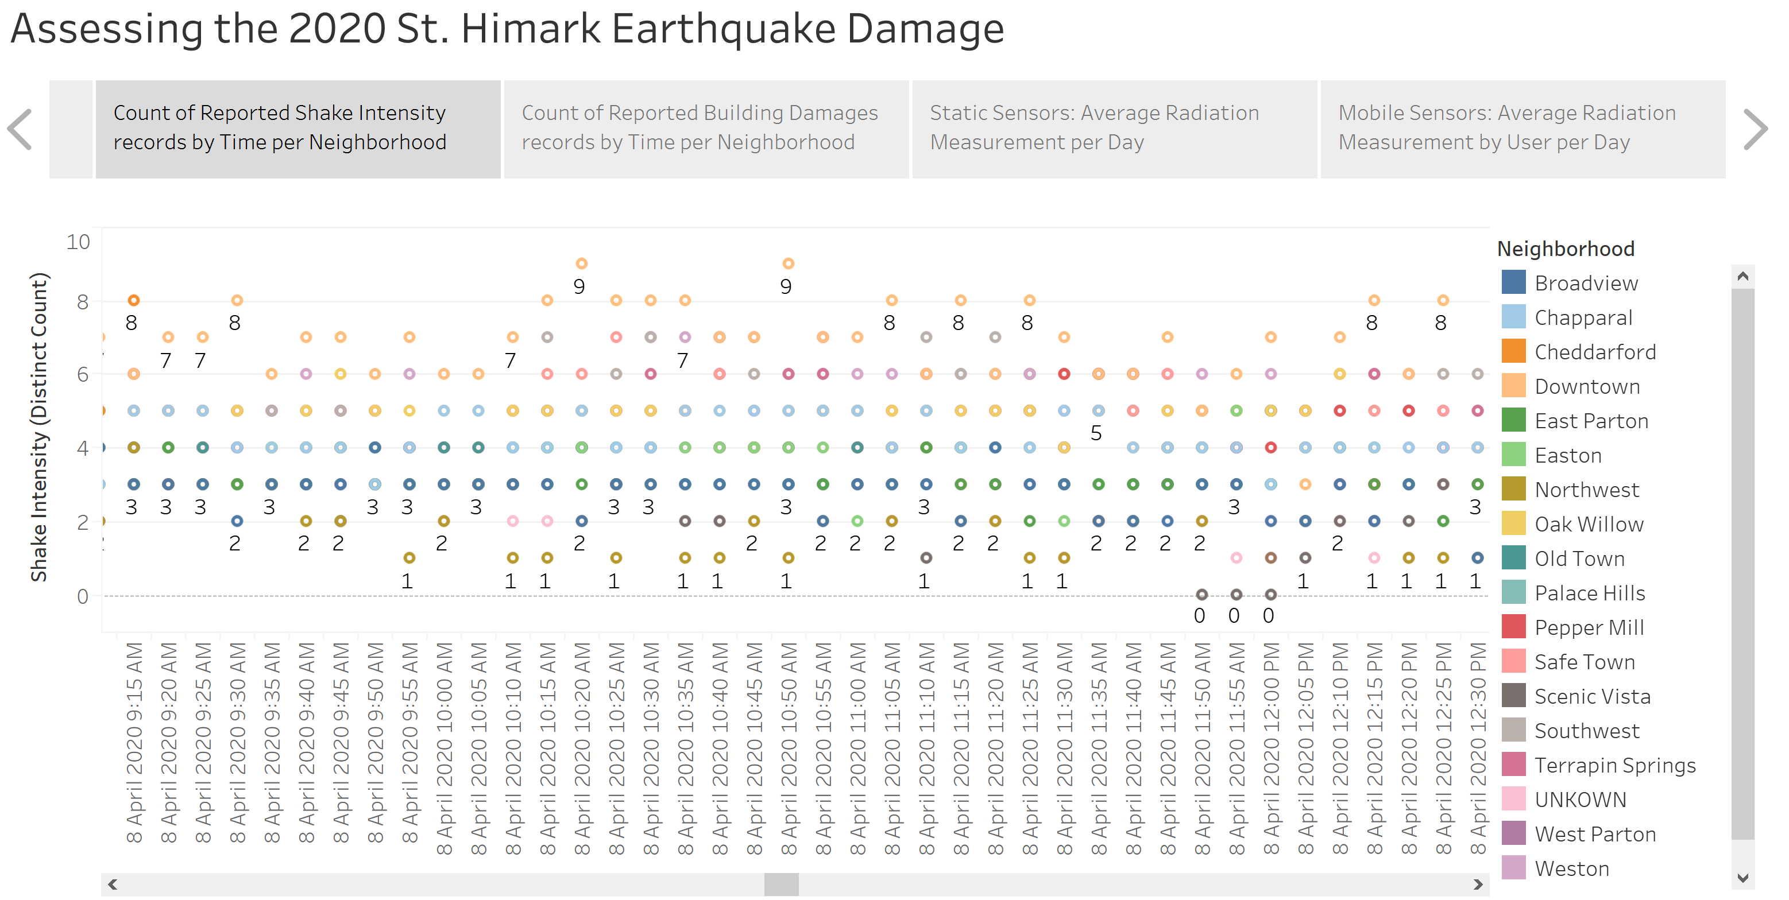
Count of Reported Shake Intensity records by Time per Neighbourhood

Slide 11
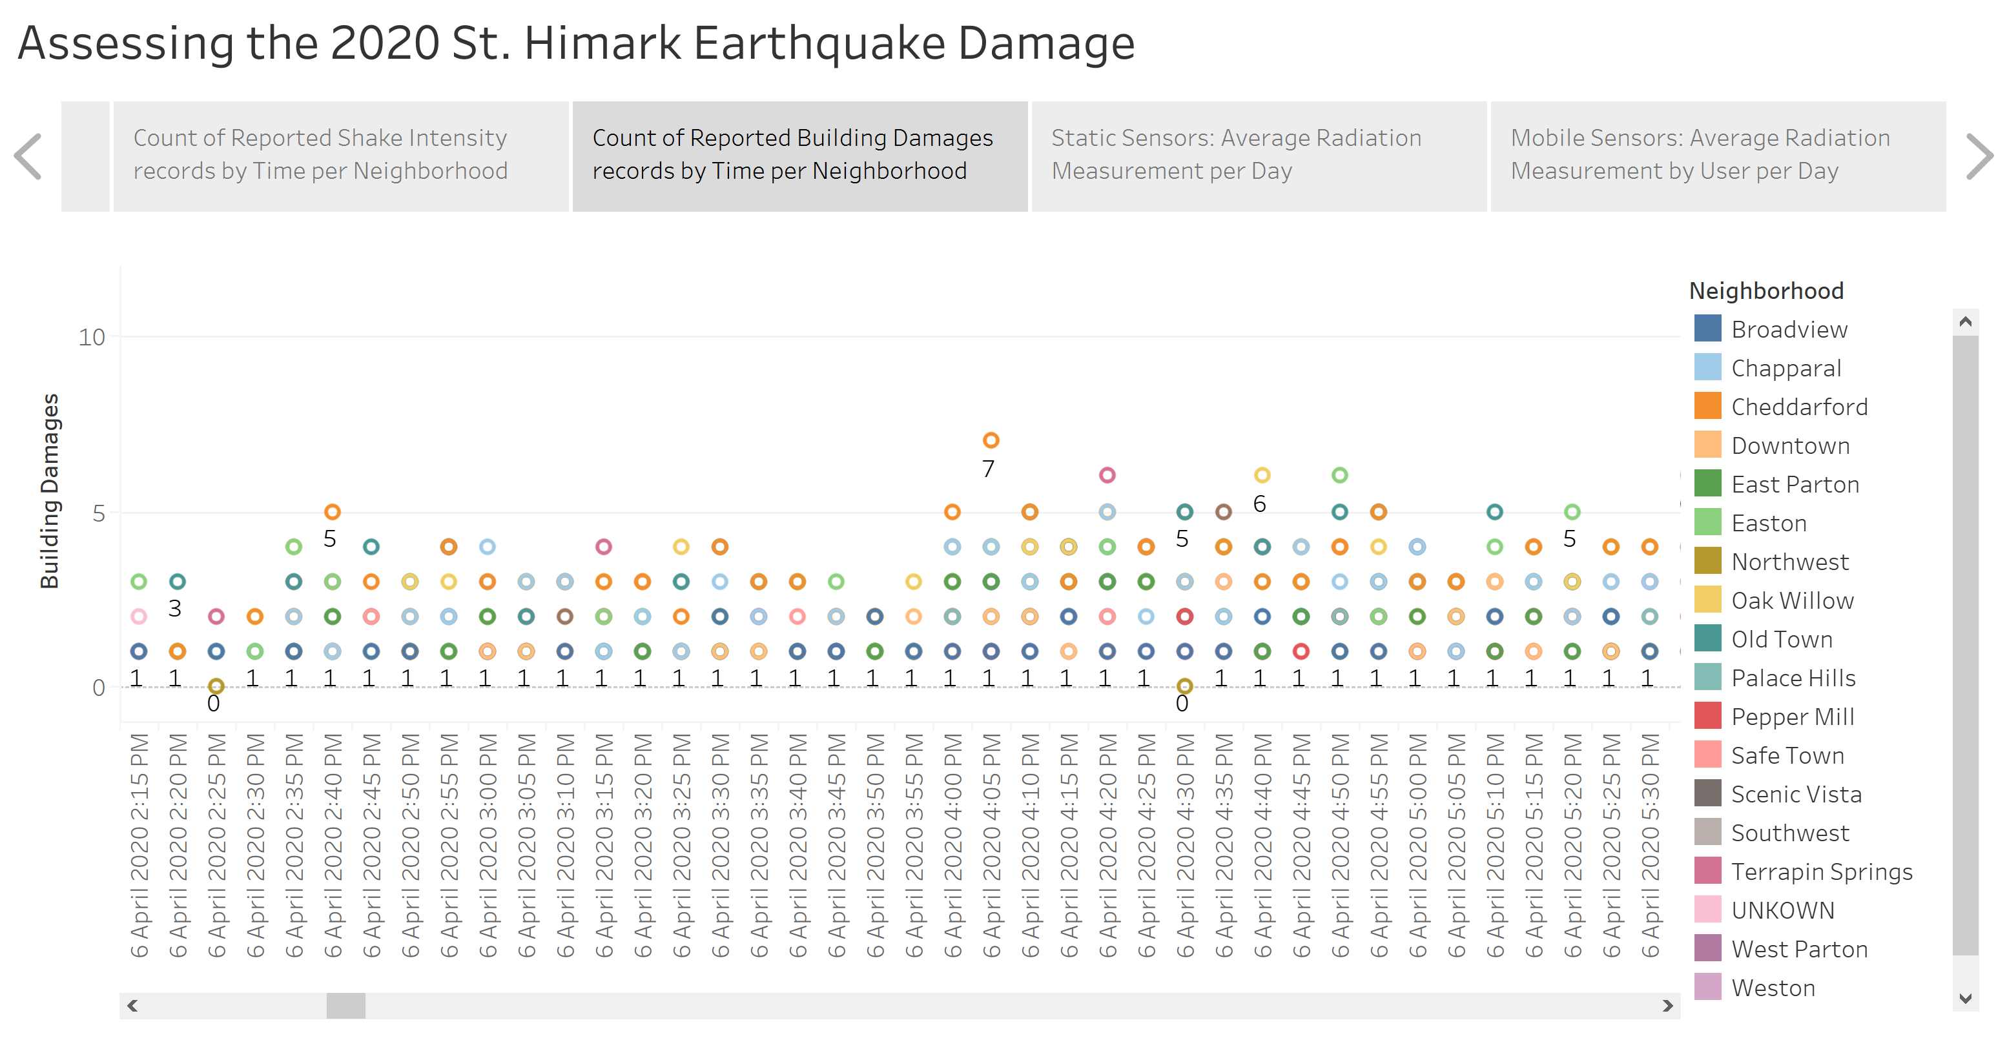
Count of Reported Building Damages records by Time per Neighbourhood

Slide 12
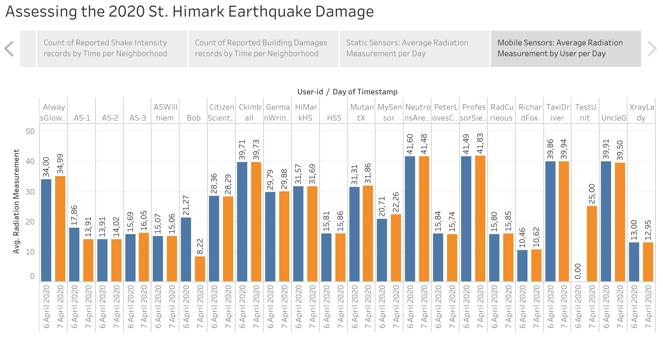
Mobile Sensors: Average Radiation Measurement by User per Day

